Slide 1
Object-Oriented Programming
WEEK 02 Abeeha Sattar

Slide 2
Class Diagrams
Class name (or identifier): identifies the class.
Data Members or Variables (or attributes, states, fields): contains the attributes of the class.
Member Functions (or methods, behaviors, operations): contains the dynamic operations of the class.
Class Name
Data Members
Member Functions

Slide 3


Examples of Classes
Person
-Name : string
-Age : int
Class Name
Data Members
+Walk(): void
+Talk(): void
+Eat(): void
Member Functions
Pokemon
-Type : string[]
-Height : float
-Weight : float
+Attack(): void
+Dodge(): void

Slide 4
Examples of Objects
Emily : Person
Dragonite : Pokemon
Name = “Emily”
Age = 29
Type = {“dragon”, “flying”}
Height = 2.2
Weight = 210
Walk()
Talk()
Eat()
Attack()
Dodge()

Slide 5
Let’s map the class diagram to code now!
Class Person {
string Name;
int Age;
void Walk() {//walk}
void Talk() {//talk}
void Eat() {//eat}
};
Person
-Name : string
-Age : int
+Walk() : void
+Talk() : void
+Eat() : void

Slide 6
Let’s map the class diagram to code now!
???
Pokemon
- Type : string[]
- Height : float
- Weight : float
+Attack(): void
+Dodge(): void

Slide 7
Creating an object of a class:
int main() {
Person Emily;
Pokemon Dragonite;
}
But we can’t access any of the variables or functions we made : ( How do we fix that?

Slide 8
Access Modifiers | Access Specifiers
One of the main features of object-oriented programming languages such as C++ is data hiding.
Data hiding refers to restricting access to class members.
Data hiding also becomes important when we are trying to encapsulate our data!

Slide 9
Types of Access Specifiers:
Public
Private
Protected
Specifier | Accessible within same class? | Accessible within derived/child class? | Accessible outside the class?
Private | Yes | No | No
Protected | Yes | Yes | No
Public | Yes | Yes | Yes

Slide 10
The “public” Access Modifier
Fields marked as public can be accessed by anyone
Public members are accessible from any part of the program
Syntax:
class MyClass { // The class public:
int member; // Access specifier; class members go here,
// after the specifier };

Slide 11
Going back to our Person Class
Class Person {
public:
string Name;
int Age;
void Walk() {//walk}
void Talk() {//talk}
void Eat() {//eat}
};
Now we can actually use these member variables and functions inside our main!

Slide 12
Using Person Object in Main Method:
int main() {
Person Emily;
Emily.name = “Emily”;
Emily.age = 29;
Emily.Walk();
Emily.Talk();
Emily.Eat();
}

Slide 13
The “private” Access Modifier
Fields marked as private can only be accessed by functions that are part of that class
They are not allowed to be accessed directly by any object or function outside the class
By default, members are considered private, aka, when no modifier is specified!!
So that’s why we couldn’t do anything before!

Slide 14
Let’s modify our Person Class again!
Class Person {
private:
string Name; // according to our class diagram these fields are private (the ‘–’ sign)
int Age;
public:
void Walk() {//walk}
void Talk() {//talk}
void Eat() {//eat}
};

Slide 15

Do the same for your Pokemon class

Slide 16

How will this impact our main function?
int main() {
Person Emily;
Emily.name = “Emily”;
Emily.age = 29;
Emily.Walk();
Emily.Talk();
Emily.Eat();
}
So how will we ever edit these fields?

Slide 17

The “protected” Access Modifier
Protected access modifier is similar to private access modifier in the sense that it can’t be accessed outside the class
But the protected members can be accessed by the derived/child classes.
We’ll look more into protected members when practicing inheritance.
For now that is all you need to know

Slide 18
Accessor & Mutator Functions
Widely referred to as getters and setters.
Set functions are also sometimes called mutators (because they mutate, or change, values)
Get functions are also sometimes called accessors (because they access, or retrieve values).
They help us solve the problem of private fields being inaccessible in the main function.

Slide 19
Getters | Setters
A class’s private data members can be manipulated only by member functions of that Class.
These member function names need not begin with set or get, but this naming convention is common, and highly advised.
Providing public set and get functions allows clients of a class to access the hidden data, but only indirectly

Slide 20
Going back to our person class…
Class Person {
private:
string Name;
int Age;
public:
void setName(string name) {
Name = name;
}
string getName() {
return Name;
}
void setAge(int age) {
Age = age;
}
int getAge() {
return Age;
}
void Walk() {//walk}
void Talk() {//talk}
void Eat() {//eat}
};
Setters
Getters

Slide 21
Going back to our Main Function…
int main() {
Person Emily;
Emily.setName(“Emily”);
Emily.setAge(29);
Emily.Walk();
Emily.Talk();
Emily.Eat();
cout << “Name: ”<< Emily.getName() << endl;
cout << “Age: ” << Emily.getAge();
}
Using the setters that we made to set the values of name and age
Using the getters that we made to get the values of name and age, and print them using cout

Slide 22

Update your Pokemon class and Main Method

Slide 23
Encapsulation
One of the principles of OOP
Encapsulation is a process of wrapping of data and methods in a single unit
The main advantage of using of encapsulation is to secure the data from other methods, when we make a data private then these data only use within the class, but these data not accessible outside the class.

Slide 24
Encapsulation
In C++, encapsulation is used along with the classes and access specifier concept.
Encapsulation is the process of combining data and function into a single unit called class.
You can say it as a protective wrapper that stops random access of code defined outside that wrapper.

Slide 25
Think of the class as a capsule the holds together the medicine
In this case, methods and variables are the medication
And the class is the capsule itself!
variables
methods

Slide 26
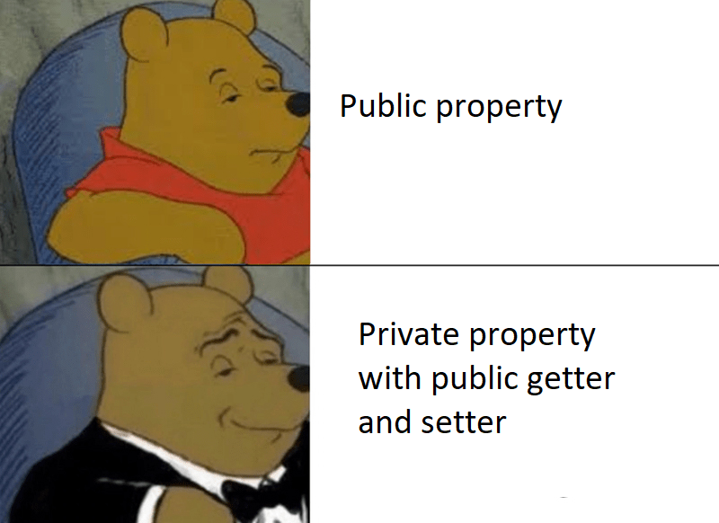

Slide 27
Why do we want to Encapsulate Data?
Simplicity | Clarity
Better understanding of the code
Lowers code complexity
Manage/Limit data access

Slide 28
Header Files and Encapsulation
You can place your classes inside header files(.h file extension)
You can then have your very own library that you can include in your working code (.cpp files)
You can use your class in your working code, after you’ve included the library

Slide 29
Defining Functions (outside of the class)
Scope Resolution Operator ( :: )
Class Person {
private:
string Name;
int Age;
public:
//here we just defined the signatures
void Walk();
void Talk();
void Eat();
}
void Person::Walk() {
cout << “Walked a step”;
}
void Person::Talk() {
cout << “Said something”;
}
void Person::Eat() {
cout << “Ate a borger”;
}

Slide 30
Abstraction
A way to selectively show only the relevant details of an object
Principle of abstraction:
“Capture only those details about an object that are
relevant to current perspective”

Slide 31

Abstraction
Perspective: A point of view
The person only knows there is a book window for borrowing and returning books, he doesn't care or doesn't need to know about how the book is found and what happens before and after he requests or return a book
Let’s identify the things that are relevant to the
Borrower - ???
Librarian - ???

Slide 32
Abstraction – Advantages
Simplifies the model by hiding irrelevant details
Abstraction provides the freedom to defer implementation decisions by avoiding commitment to details

Slide 33
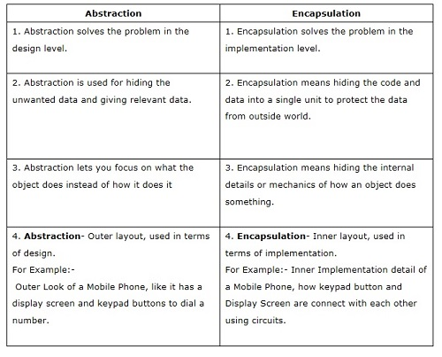
Abstraction v/s Encapsulation

Slide 34
Fin.
: )

